Slide 1
First test of new ATA LNA with Chalmers and IAF MMICs
2013-10-22

Slide 2
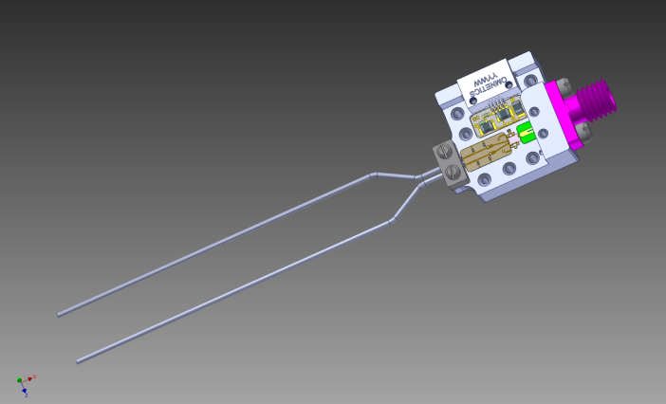
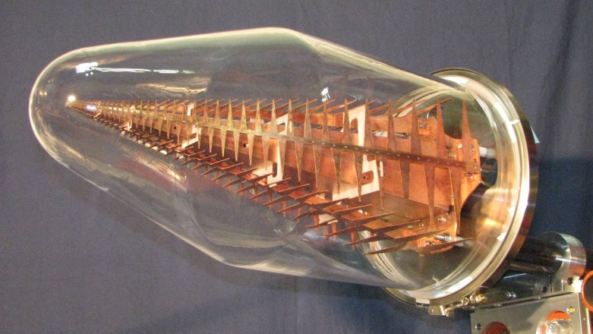
New ATA LNA
New ATA LNA
Tip of feed
Chalmers MMIC
IAF MMIC
Feed in glass bottle

Slide 3
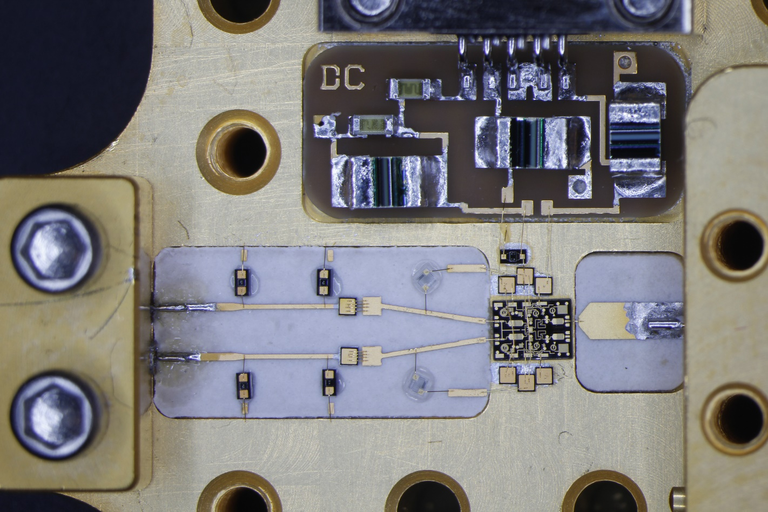
Module photo

Slide 4
Room temp results
Measurements are done in 50 ohm environment. The 50 ohm connector is deembedded, but some effect remains causing the ripple. The plot shows differential mode performance with 200 ohm source and 50 ohm load impedance.
The high Vd and Vm and the gain tilt in the Chalmers MMIC are due to a processing problem which will be solved for next wafer run.

Slide 5
Room temp results, cont’d

Slide 6
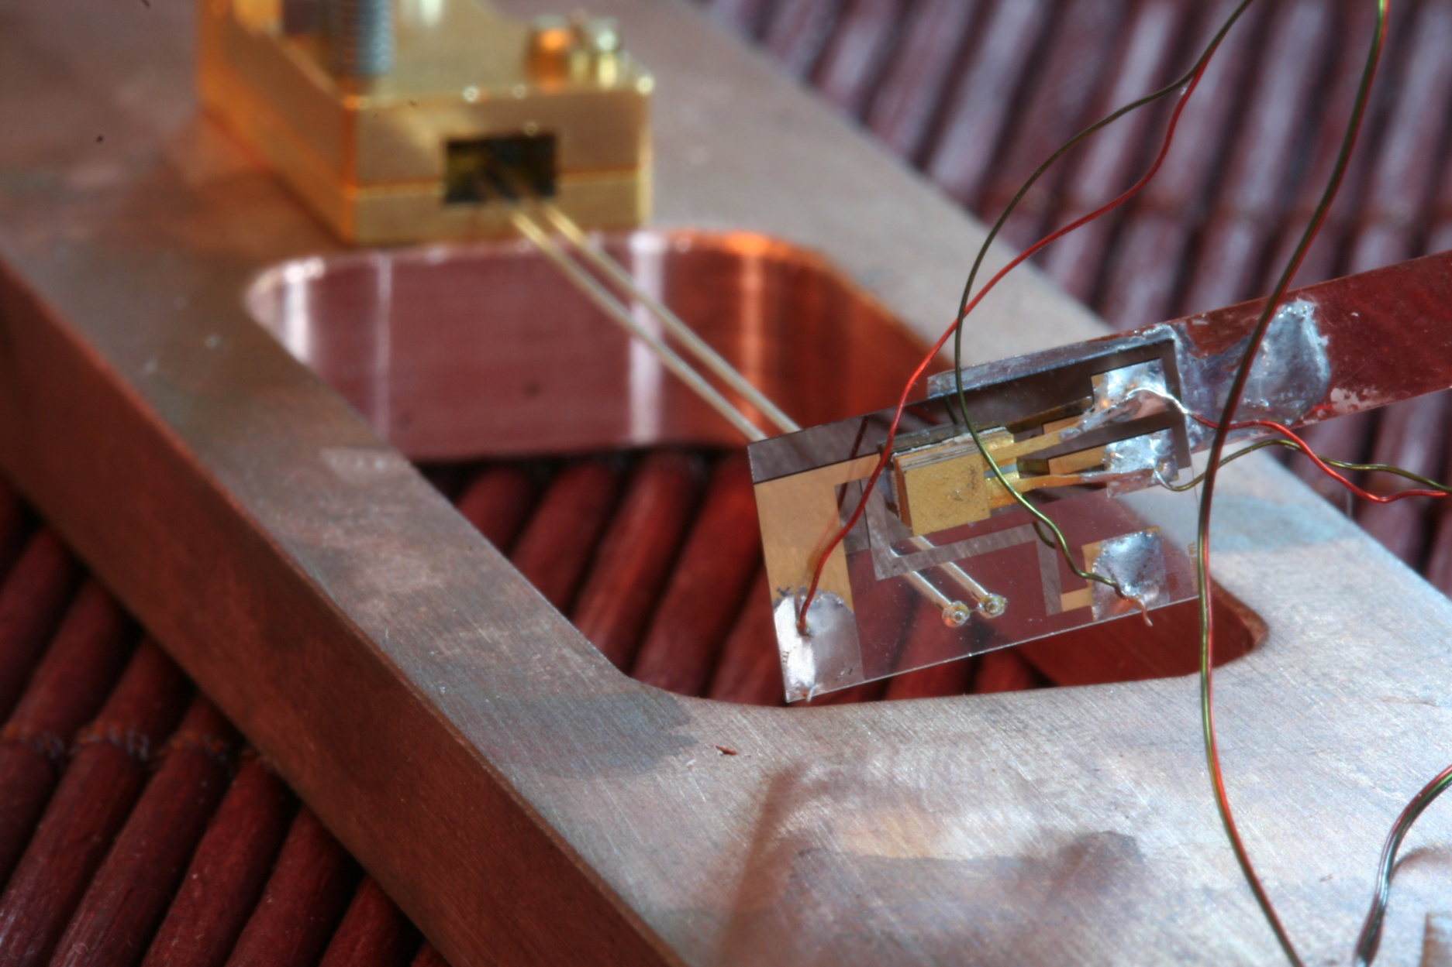
Variable temperature load test system
Long thin copper shim connected to the cold plate. No heating of the DUT was observed when the heating resistor was used
Temperature sensor
Old style ATA amplifier module (DUT)
Crystal quartz susbtrate
200 ohm balanced twin lead transmission line
200 ohm termination resistor (actual value=191 ohm)
Heater resistor

Slide 7
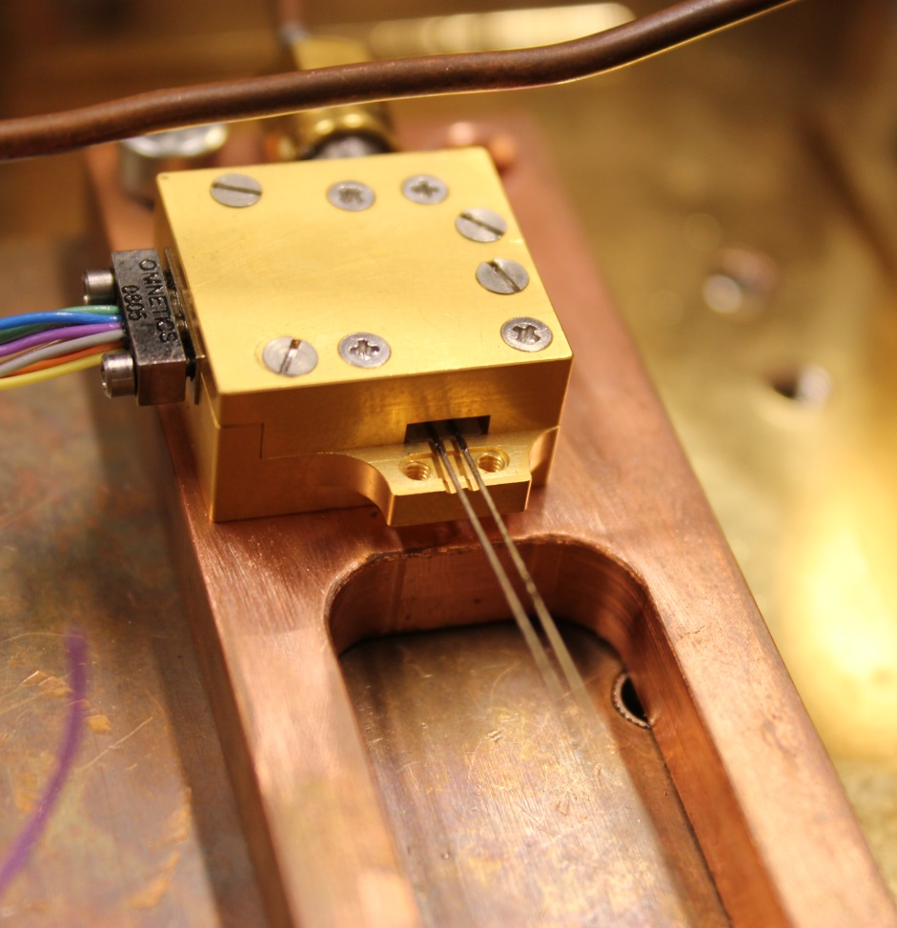
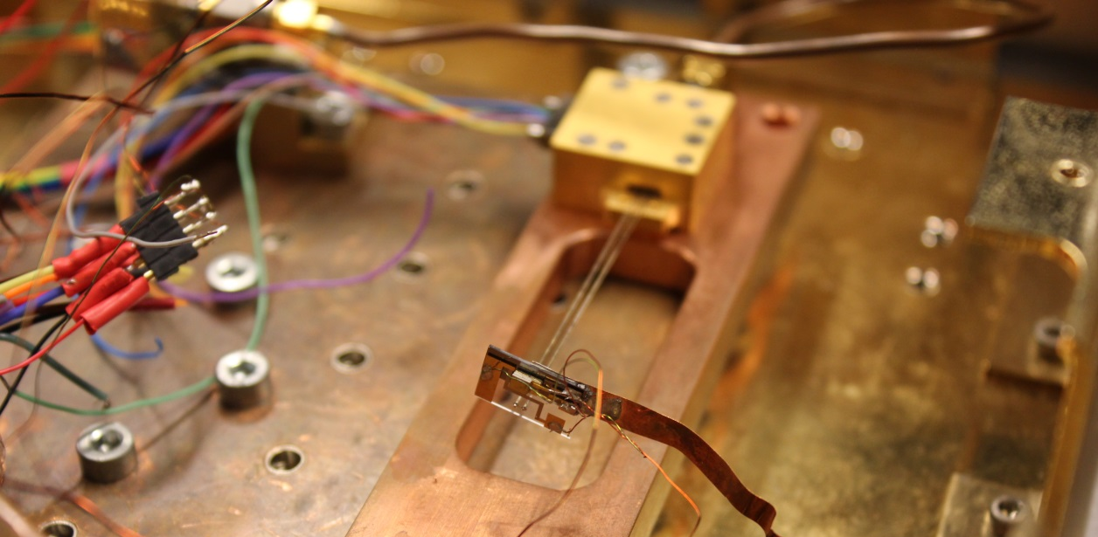
Impedance mismatch with new module in the test system
The twin lead line passes close to ground. This reduces the impedance. The system is designed for old style module.

Slide 8
Mismatch effect on measured noise

Slide 9
Test result at 13K

Slide 10
Test result at 65K

